Slide 1
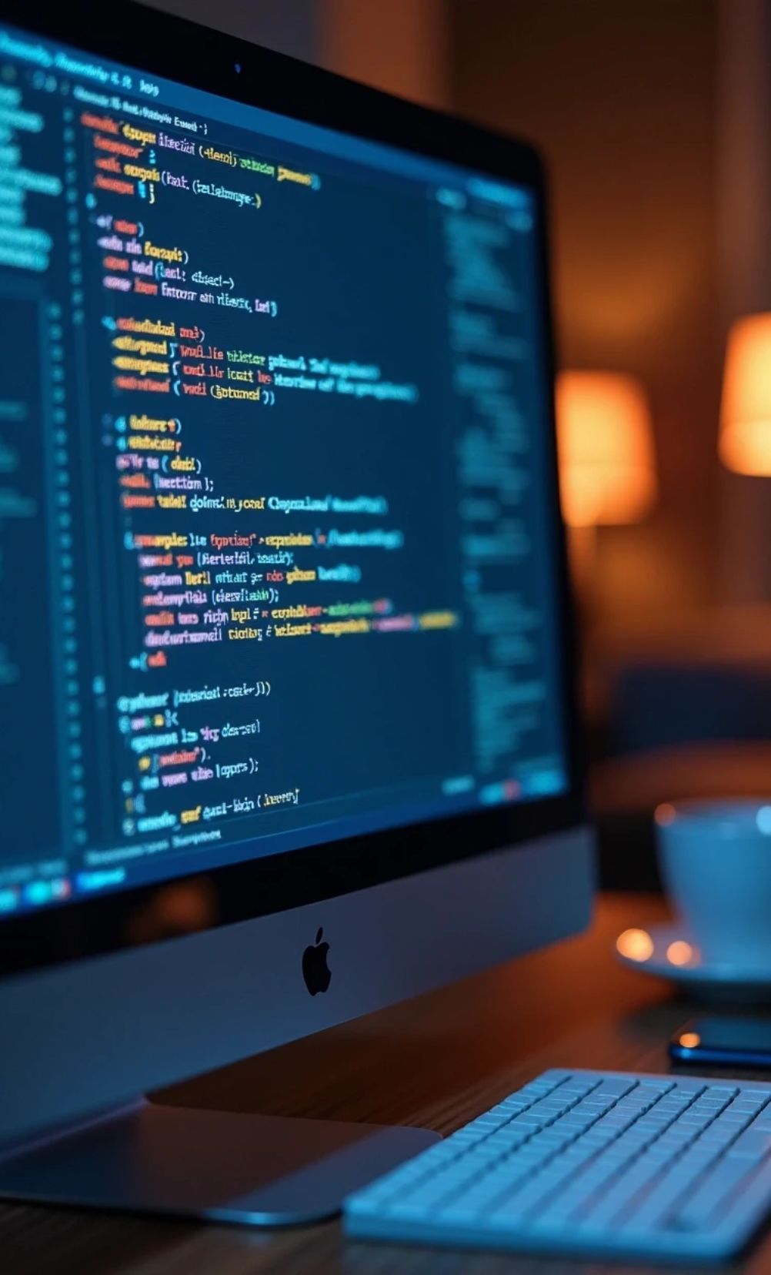

Introduction to Python
Programming
What is programming
Purpose of programming
Why logic matters
What are variables, data types, age calculator
Presentation By Sadia Waleed

Slide 2



What is Programming?
Definition of Programming
Purpose of Programming
Importance of Logic
P
Programming means creating a set of instructions that a computer can understand and follow. It is the process of planning, writing, testing, and fixing computer programs so that they can perform specific tasks, like solving problems, showing messages, or running games and apps.
The main goal is to solve problems and create software applications that automate tasks, analyze data, or enhance user experiences.
Logic serves as the backbone of programming, helping create algorithms and control program flow. Logical reasoning aids in identifying errors and optimizing code.

Slide 3
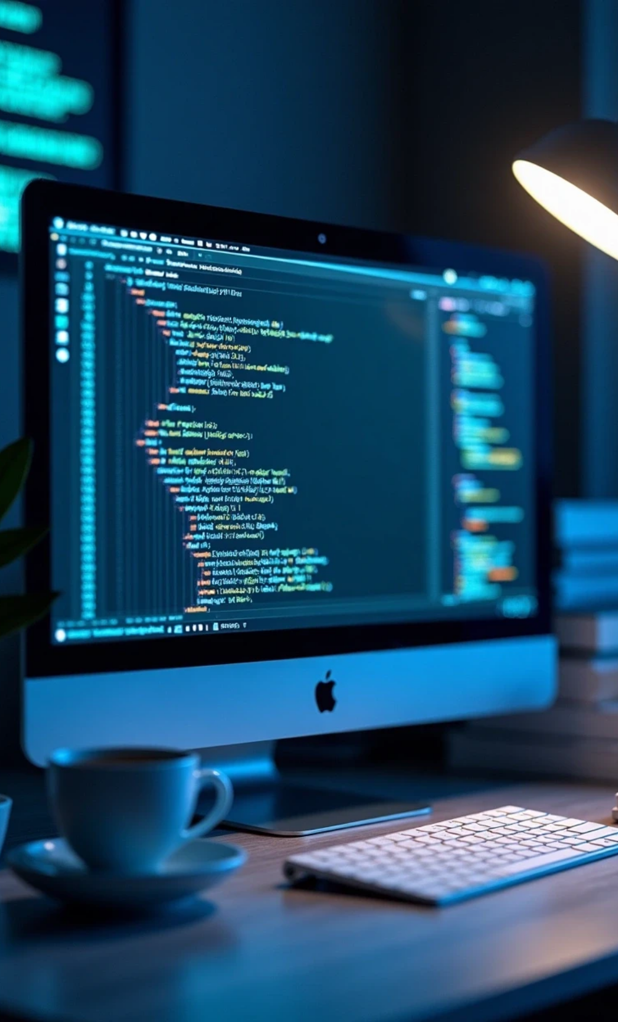
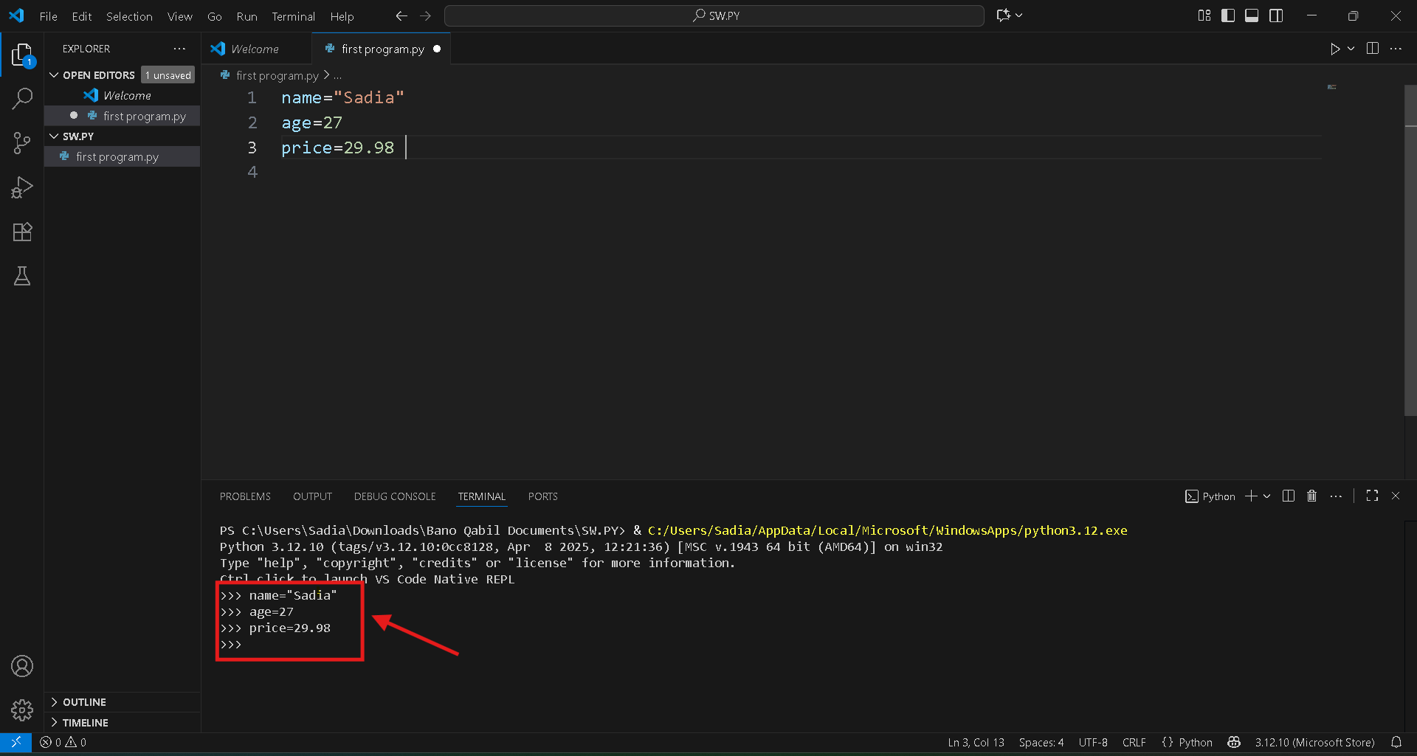
Understanding Variables and Data Types
Definition of Variables:
Variables are containers or a box in your computer’s memory where you store information
Common Data Types
Python supports various data types, including integers, floats, strings, and booleans, which are essential for performing different kinds of operations.
Dynamic Typing
Python uses dynamic typing, meaning variables can hold different data types at different times, allowing for more flexibility in programming.

Slide 4



Expressions and Operations in Python
Understanding Expressions
Arithmetic Operations
String Manipulation
An expression combines values and operators that Python interprets for new results.
Python offers basic arithmetic operations such as addition, subtraction, multiplication, and division.
String expressions can be processed with concatenation or formatting for dynamic data interaction.

Slide 5



Understanding Simple Conditions
Else and Elif
2
These constructs extend conditional logic for multiple pathways.
If Statements
1
Conditional statements allow decision-making in code.
Practical Use
3
Conditions control application flow based on user input.

Slide 6
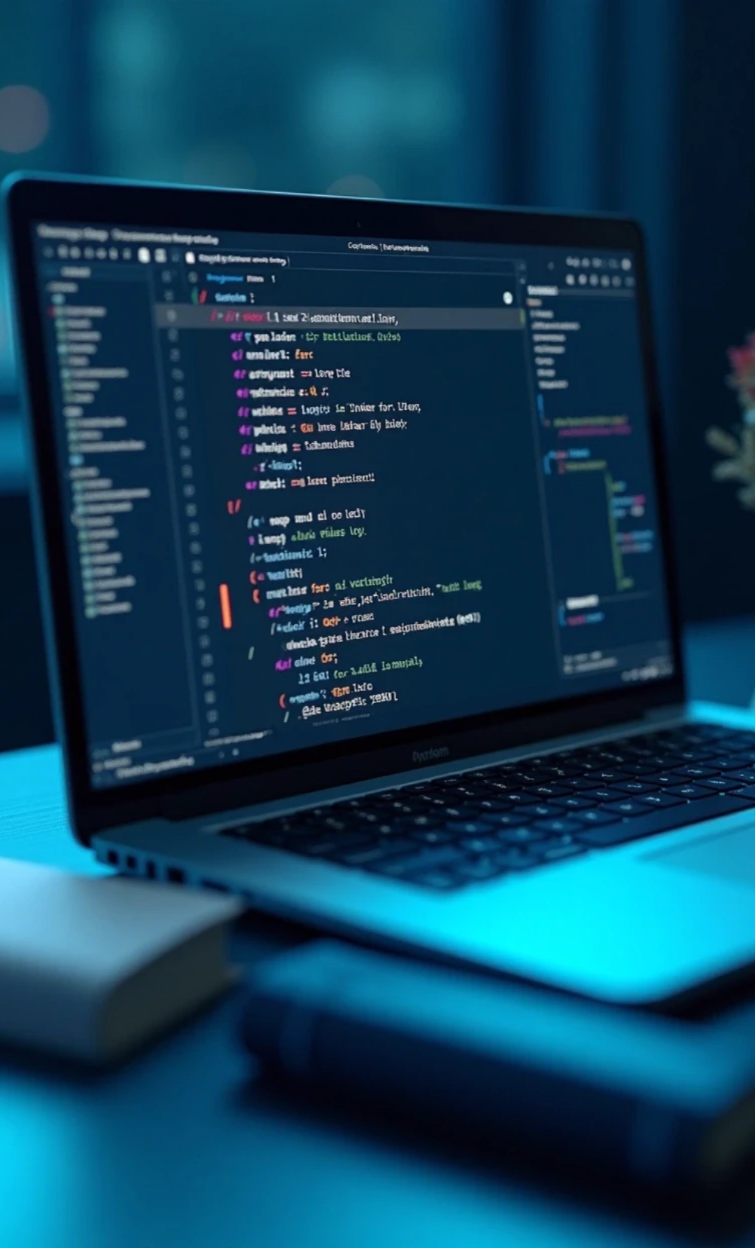
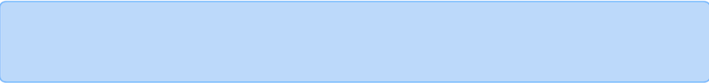
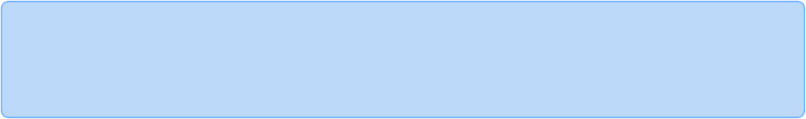
Loops in Programming
What are Loops?
Loops are constructs that repeat code based on a condition, enhancing efficiency.
Types of Loops
Python includes for and while loops for iteration over sequences or condition checks.
Use Cases
Loops assist in processing collections and simplifying code logic through repetition.

Slide 7
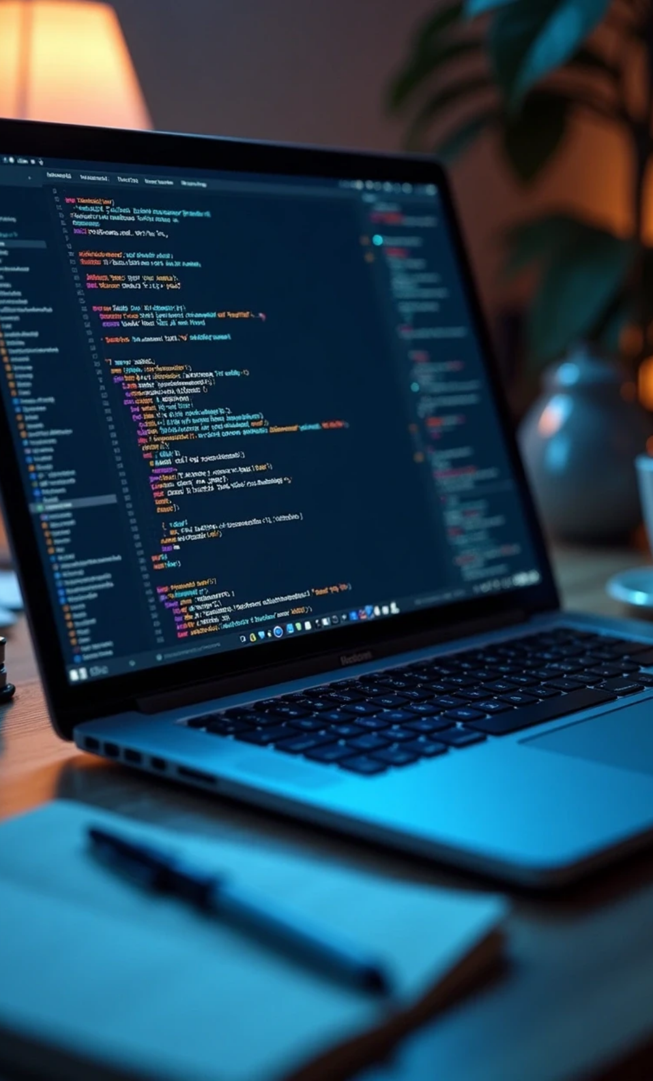
Conclusion of Python Programming
In conclusion, the presentation has emphasized the importance of foundational Python programming concepts. Each segment has contributed to a better understanding of how to approach learning programming effectively, encouraging further exploration and practice.
Recap of Key Concepts
The presentation has covered essential aspects of Python programming.
Next Steps in Learning
To enhance your programming skills, consider practicing with sample codes.
Final Thoughts
Embrace the journey in learning programming, as it opens up a world of possibilities.

